Slide 1

Project Status
of
INSTITUTE SEARCHER
SUBMITTED BY:
1. Jayant Singh Jhala
20CS002272
2. Nitesh Agrawal
20CS002278
B.Tech(CSE AI&ML) 4th Sem
SUPERVISED BY:
Dr. Amit Jain
Assistant Professor
(School of Engineering)

Slide 2
Introduction
The Goal of our project as initially set by us, was making the Institute ranking useful to people those who are searching for various top institute options in India.
Thereby, Cutting the need of hectic Systems available, most of which are hard to navigate and with ton of confusing and irrelevant data.
We have Developed our software to serve with as basic as possible navigation options made available in one single system.

Slide 3
Current System
Larger number of ranking scientific institutions.
Disadvantages by being less user friendly and moreover confusing.
Overcome by introducing certain improvements within the system of exploring the options.
Improve Current System and prevent possible confusion among the users.

Slide 4
Proposed System
providing user with ability to search through various top institutions in India.
Ample amount of search options available.
Scores, their rankings etc. that are obtained by the ranking process of Institutions according to the National Institution Ranking.
Collection, analysis of data and Feed that data into a pre-structured database.
easy to redraft programming framework.

Slide 5
Hardware Requirements
 | MINIMUM | RECOMMENDED
CPU | 64bit x64 CPU | Multicore 64bit x64 CPU
RAM | 4 Gigabytes | 8 Gigabytes
DISPLAY | 1024x76 | 1920x1200

Slide 6
Software
Requirement
Windows 7 or Later (64-bit)
Python 3.9(Recommended)
MySQL 8.0.28 or Later

Slide 7
Flow Chart
Start
Read
Search Filter Data
Read
Table Choice
If
Exit Program?
Generate Query
Yes
Run Query
No
Read
Search Type
Print Fetched
Data
If
Exit Search?
Yes
No
End

Slide 8
Entity Relationship Diagram
Name of Institution
Institute ID
Institute ID
Primary
Key
Rank
Attribute
City
Searching
System
Attribute
Rank
State

Slide 9
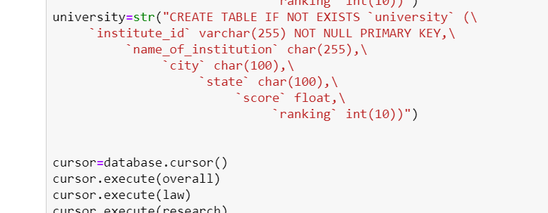

Creating table

Slide 10
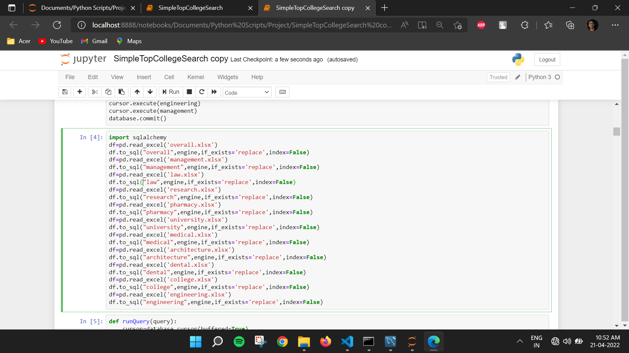
Transferring Data to Relation

Slide 11
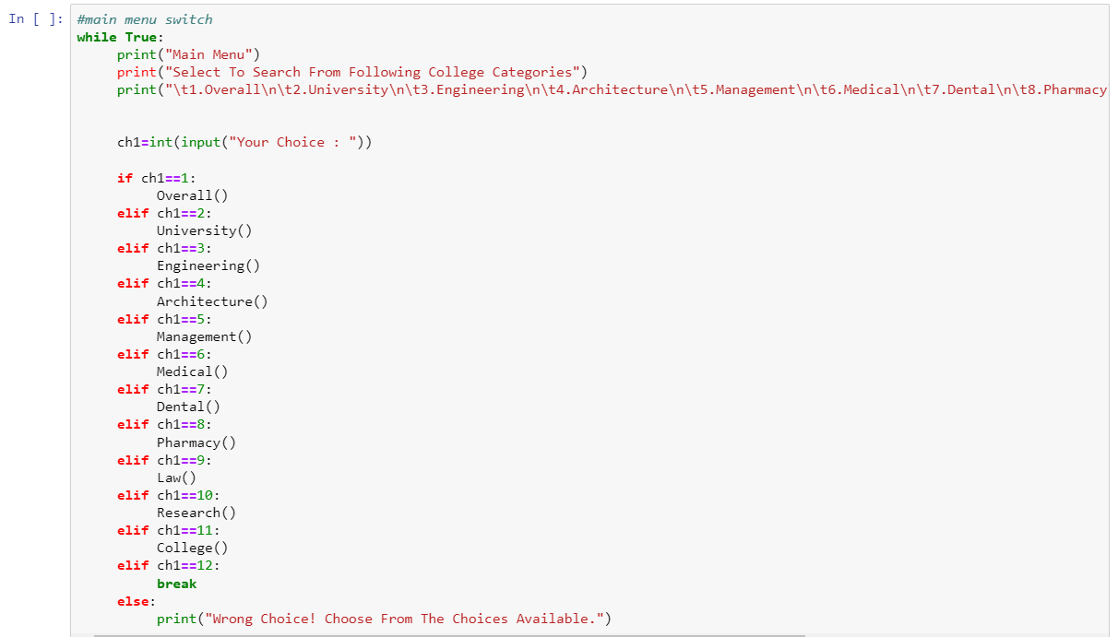
MAIN Menu Program

Slide 12
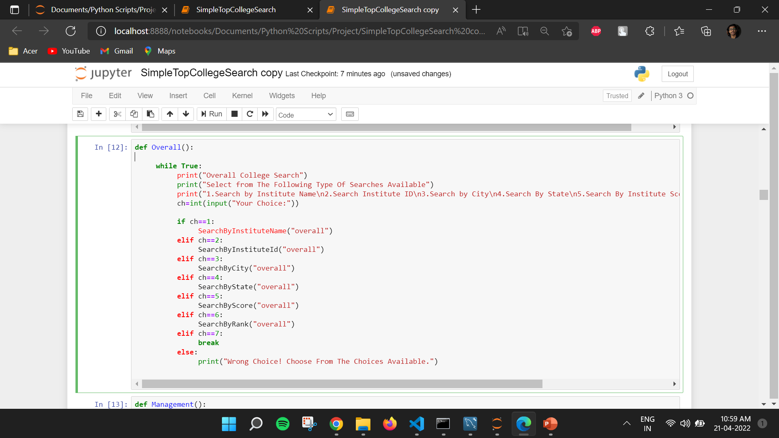
Specific Field Function

Slide 13
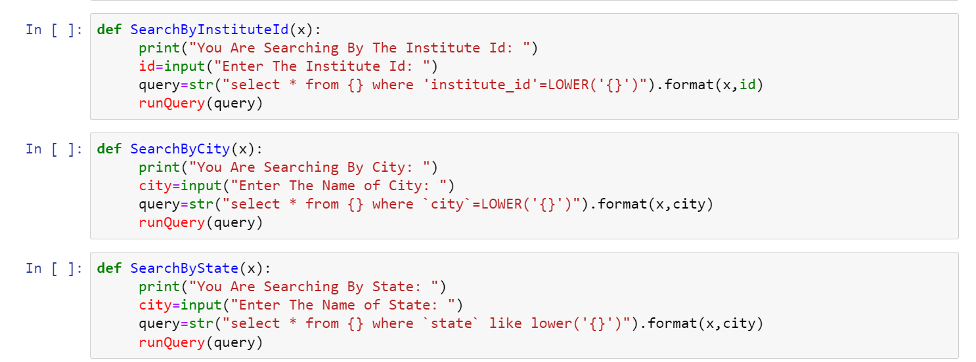
Type of Search Function

Slide 14
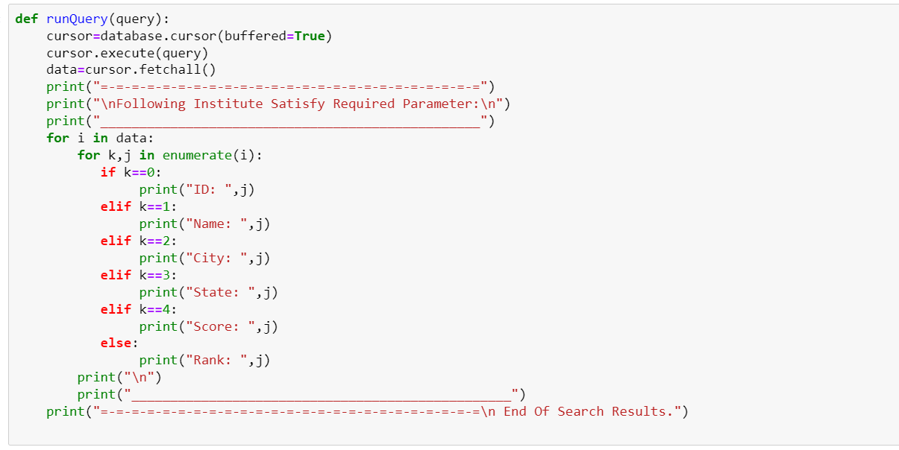
Running generated Query

Slide 15
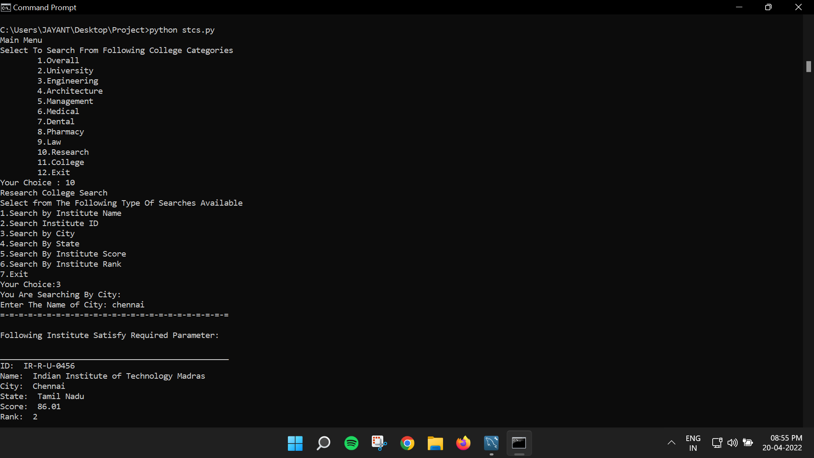
Sample Run

Slide 16
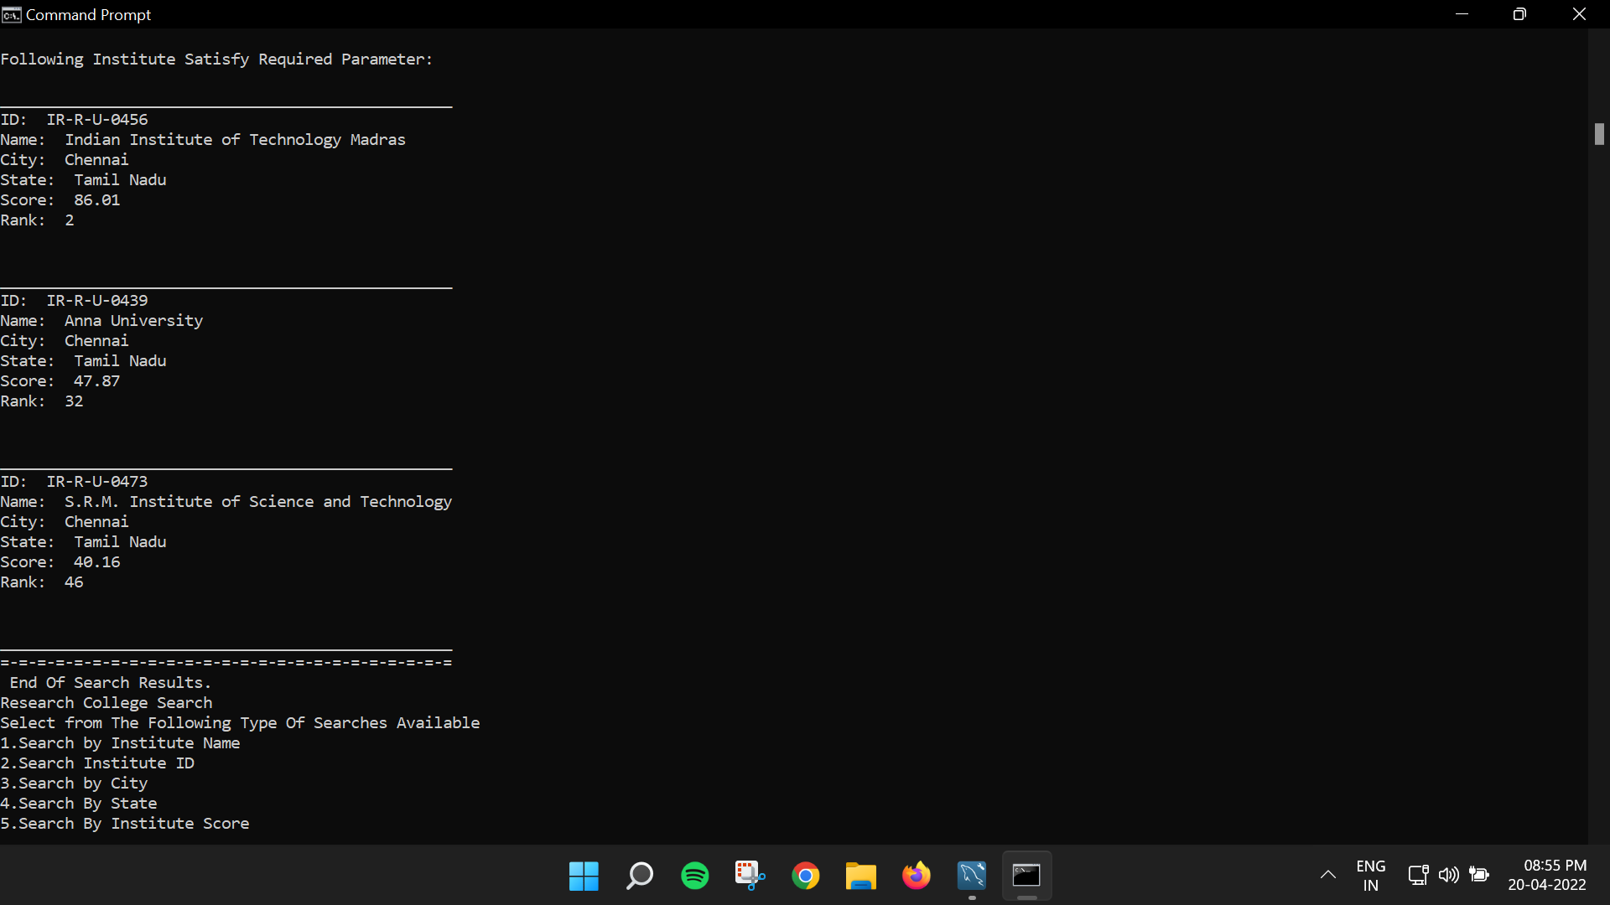

Slide 17
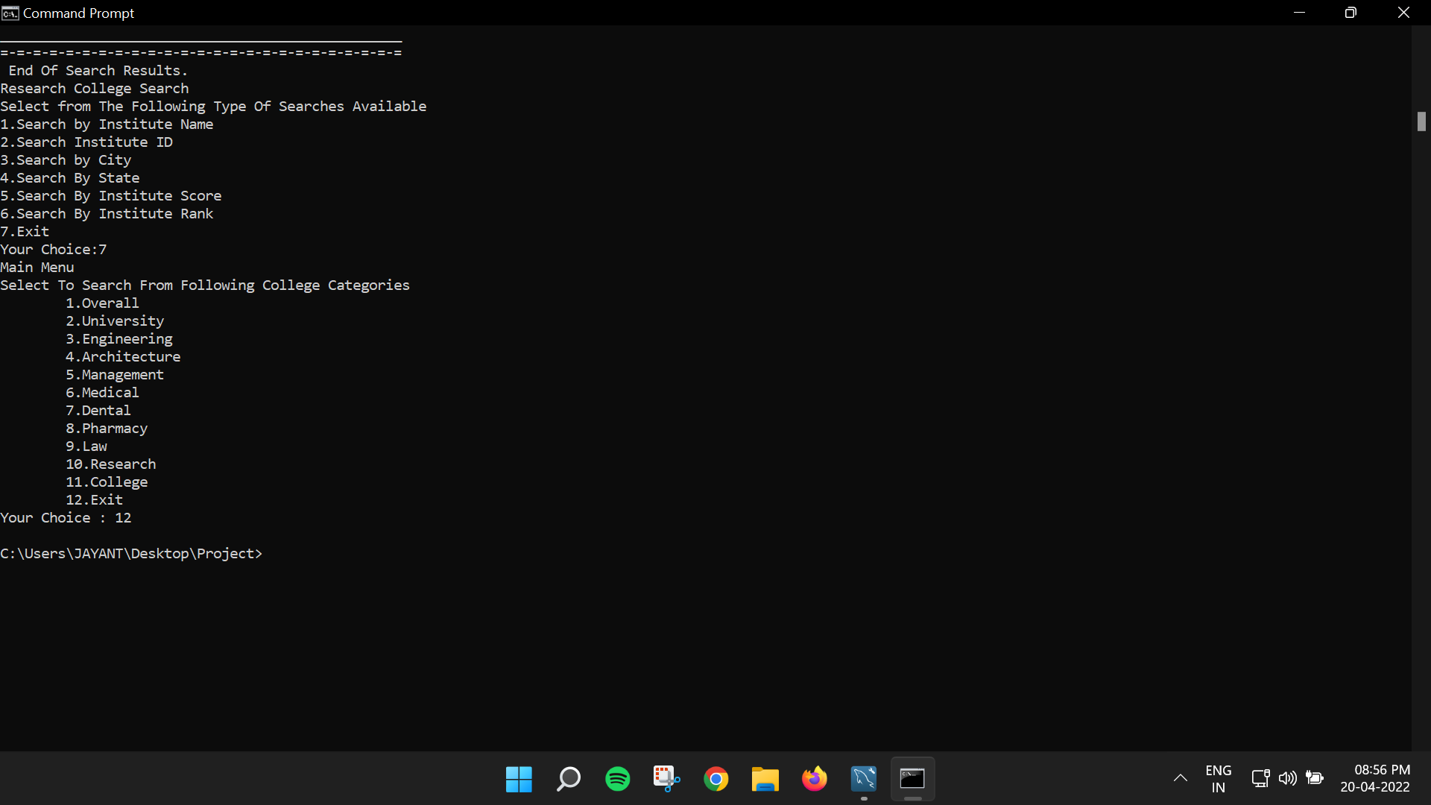

Slide 18
Timeline
January:
Institution data Collection
Cleaning of Data
February & March:
Collection of required programming knowledge
Writing the required code
debugging alongside programming the system

Slide 19
Timeline (Cont’d)
April:
Removing possible unnoticed flaws in the code
Final compilation of the Package
May:
Final Submission Of the Project

Slide 20
References
https://www.nirfindia.org/2021/Ranking.html
https://www.geeksforgeeks.org/
https://www.javatpoint.com/
https://github.com/

